Slide 1

Working Capital Management
Purchase to Pay – Technique Paper
The full scope of Cash and Working Capital Management (CWCM) services is not permissible for SEC audit clients and their affiliates or IFAC PIE audit clients and their related parties. CWCM services are generally permissible for IFAC non-PIE audit clients subject to evaluating engagement circumstances using the conceptual framework (i.e. threats and safeguards approach) and provided we do not assume a management responsibility as outlined in the Global Quality & Risk Management Manual Chapter 11. See detailed guidance regarding Independence on slides 11-16 of the CWCM methodology guide.
RESTRUCTURING
August 2008
ADVISORY
For the purpose of this document, all references to KPMG International, a Swiss cooperative that serves as a coordinating entity for a network of independent member firms operating under the KPMG name, will be referenced as KPMG International. Throughout this document, "KPMG" ["we," "our," and "us"] refers to the local, independent KPMG member firm or firms. Throughout this document “client” [“they,” “their and “them”] refers to the local, independent member firm’s client. KPMG International provides no client services.

Slide 2
Contents
Topics Covered Slide Number
Introduction Slide 2
Section 1: Working capital overview and example approaches Slide 3
Section 2: Purchase to Pay overview Slide 7
Section 3: Diagnostic Data Analysis Slide 16
Appendix: Overview of Approach for Release of Working Capital Opportunities Slide 45

Slide 3
Introduction
  Title of Document: Purchase to Pay Technique Paper
  Purpose of this document
  This technique paper covers the key processes and identifies main improvement areas within the Purchase to Pay (P2P) cycle, as well as identifying tools and example tests. The tools comprise of: Data request, Guidance on holding workshop’s, Leading Practices, Diagnostic Questions, Suggested data analysis, Guidance on reporting observations and recommendations. For the Leading Practices and Diagnostic Questions, please refer to the Cash and Working Capital Management Microweb (click here).
When and how to use this document: These tools and tests can be used by the practitioners when conducting the data analysis during a P2P diagnostic within the Assess phase of a Cash and Working Capital Management (C&WCM) engagement, to identify working capital opportunities.

Slide 4
Section 1
Working capital overview

Slide 5
Working capital processes
  Three key processes comprise working capital as follows:
Component
Process
Key processes
Order to cash
(OTC)
  Customer Acceptance
  Sales management
  Credit risk management
  Order management and invoicing
  Collection
  Dispute management
  Cash allocation
Revenue management
  Planning
  Sourcing
  Making
  Deliver and return
Working Capital
Inventory
management
Forecast to deliver
(FTD)
Expenditure management
Purchase to Pay
(P2P)
  Procurement strategy
  Supplier selection and contracting
  Requisition order management
  Receiving and supplier management
  Discrepancy management
  Invoice processing and payment management

Slide 6
Diagnostic Analysis Approaches
  To be able to identify Working Capital Opportunities, we aim to perform a detailed Diagnostic Analysis with the client. However, there may be a requirement to undertake a ‘lighter touch’ analysis ahead of performing the detailed Diagnostic Analysis. This may comprise either: a Desktop Assessment; or a Rapid Assessment. The differences in each approach are summarised below:
It is recommended to undertake a detailed Diagnostic Analysis instead of these steps
 | Desktop Assessment | Rapid Assessment | Detailed Diagnostic Analysis
Key people | Sponsor, Controllers | Sponsor, Controllers, Main Director Level Managers | All key people in organisation supporting WC processes
Objectives | Provides a very high level analysis and understanding of opportunities. Should support the case for a detailed Diagnostic Analysis. | To review and provide direction on which areas need to be included in Diagnostic phase To get buy in from local management and key decision makers for detailed Diagnostic Analysis | Identify and quantify opportunities to release cash from working capital
Activities | Remote, data driven analysis. High level questionnaires. Validation of findings. | High level Process Interviews with key people. Data Analysis. Validation of findings. | Workshops. Detailed process interviews. Define detailed gaps against better practices and identifies opportunities.
Duration | 1 to 10 days depending on client complexity, number of location involved and client resource commitment. | On site typically 2-3 days per capability (OTC p2p FTD) country/business depending on client complexity. | On site typically 3-6 week per capability (OTC p2p FTD) depending on client complexity.
Outcome | List of high level opportunities identified from questionnaires. | List of high level opportunities. High level process gap analysis and data analysis. Insights on possible actions to improve current performances. Actions and benefits to be validated more in detail during Detailed Diagnostic phase. | Detailed list of opportunities, with value, difficulty grid and related project plan. Detailed report on findings opportunities. Detailed list of process gaps.

Slide 7
Purchase to pay
Suggested approach for a Detailed Diagnostic Analysis
Our approach
  Our approach will vary depending on the scope of work we will undertake. For a full diagnostic review of the P2P process, we would typically:
Example timetable | Action | Who is involved?
Pre-field work | Submit data request and gather data. | CFO/AP Manager and IT.
Day 1 to 2 | Overview of Purchase to Pay process. A/P ledgers analysis to identify any issues. | CFO/AP Manager.
Day 3 to 4 | End to end workshop to understand process and peoples’ roles and responsibilities. | Purchasing. Finance and A/P. Receiving/warehouse. Legal.
Day 5 to 11 | Interview with senior person in cycle. Current reporting and monitoring analysis. Analysis to verify opportunities identified in questioning. | Purchasing. Finance and A/P. Receiving/warehouse. Legal.
Day 12 to 13 | Prepare for workshops. End to end workshop to confirm findings and shape potential solutions. | Purchasing. Finance and AP. Receiving/warehouse. Legal.
Day 14 to 15 | Consolidate and report findings. Recommend next steps | KPMG/Senior management

Slide 8
Section 2
Purchase to pay management overview

Slide 9
Purchase to pay
Overview
What processes are involved?
  Procurement strategy.
  Supplier selection and contracting.
  Requisition order management.
  Receiving and supplier management.
  Discrepancy management.
  Invoice processing and payment management.
What departments are involved?
  P2P is a cross-functional area which involves the following functions:
    Purchasing
    Finance
    Operations/Production
    Warehousing/Logistics
    Legal
General
  There is an assumption that there is a clear purchasing strategy.
  Decisions should be made on:
    Make or buy?
    Consignment stocks or vendor managed inventory (“VMI”)?
  There should be:
    Focus on: price, quality, service, terms and discounts
    Defined service level agreements for suppliers
    Total Cost of Ownership
What are our objectives?
  Our overall objectives are to understand:
    What are the goals and objectives of those involved in the P2P process?
    What policies exist to govern behaviour across the P2P process?
    What cash release opportunities may exist in the P2P process?
  To help ensure cash flow is optimised and cash impact is monitored through out the whole process.
  To help ensure management understands the trade off between current working capital employed and the financial cost of working capital.
  To enable management to assess the possible impact of future strategies on free cash flow and cost.
  In our experience optimising working capital helps improve effectiveness, lowers operating costs and improves service levels.
  To do this we will need to gain an understanding of:
    The current strategy, goals and objectives in Purchasing for selecting/monitoring/ managing suppliers
    The extent to which the company formally controls the number of suppliers and associated risks
    How and who can commit the Company to purchases and how is it controlled?
    How are suppliers selected and contracts entered into/maintained?
    How are goods ordered and receipt of goods/services recorded?
    Once invoices for goods/services are received, how are they recorded and matched?
    How are disputes handled?
    When approved, how and when are payments made?
    What is the frequency of payment runs?

Slide 10
Purchase to pay
Overview (cont.)
What are our objectives? (cont.)
  Once we understand the above and have identified weaknesses in the processes, we can identify and quantify opportunities to improve cash flow and profitability and maintain benefits through improved controls and reporting.
  Opportunities for the client to improve cash flow and profitability usually exist in the following areas:
    Improved payment terms to reduce net working capital;
    Define clear purchasing channels to avoid unmanaged spend;
    Reduce input and associated purchasing costs;
      Supplier rationalisation/leverage
      Contract negotiation
      Demand management
    Identify and minimise commercial risks and/or exposure;
    Enforce purchasing strategy, terms and conditions.
    Enhance process efficiency to reduce costs.
    Create a Total Cost of Ownership culture in procurement.
Typical benefits
Cash flow
  Extended payment terms to increase DPO.
  Ensure payment made on or after due date.
  Prevent non-agreed early payment.
  Negotiate vendor managed inventory or consignment stock agreements to reduce inventory.
  Negotiate higher levels of or maximise usage of stock cleansing / return or exchange agreements to reduce ageing and obsolescence of inventory.
Profitability
  Maximise discounts and rebates.
  Prevent late charges.
  Reduce staff numbers and handling costs.
  Reduce frequency of payment runs and lower transaction costs.
  Reduce expenditure in core and non-core spend.
  Maximise adherence to negotiated contracts and framework agreements.

Slide 11
Purchase to pay
Purchase to pay – High level process map
Procurement strategy
Supplier selection and contracting
Requisition order management
Receiving and supplier management
Discrepancy management
Invoice processing and payment management
Establish Purchasing Channels
Supplier Identification
Internal Requisition Raised
Goods/services received
Discrepancy reported to supplier/AP
Invoice matched to PO/GRNI
Budget setting
Negotiation
Purchasing Challenge
Matched to Purchase Order (PO)
Dispute managed
Invoice approved and entered
Purchasing
Policies and controls
Supplier selection and contract
Purchase Order Raised
Accepted and recorded to stock/GRNI
Debit/Credit note processed
Invoice paid
Supplier set up
Purchase Order Tracked
Discrepancy identified

Slide 12
Purchase to pay
High level process and key activities
Procurement strategy
Supplier selection and contracting
Requisition and order management
Receiving and supplier management
Discrepancy management
Invoice processing and payment management
Establish purchasing channels | Supplier selection and appraisal documents | Requisition generation and order management | Order tracking | Discrepancy processing (i.e. non-PO, wrong price) | Invoice matching
Segmentation model and supplier strategy | Negotiating strategy | Purchasing authority limits | Goods/service receipting | Discrepancy resolution | Discount/ terms/ management
Budget setting | Contract creation and management | Demand management | Inspection and registering | Root cause elimination | Payment frequency
Purchasing policies (controls, authorisation limits, terms) | Supplier master file management | Purchasing channel adherence | Supplier performance management (accuracy, quality, timing) | Credit note management recovery | Payment method and control
 | Contract maintenance and adherence | Purchase order management |  |  | Cash forecasting
 |  |  |  |  | Reporting and reconciliation

Slide 13
Purchase to pay
Processes – key issues
Procurement strategy
Supplier selection and contracting
No defined purchasing channels People able to buy from without control from unvetted suppliers. Significant leakage outside of negotiated contracts/framework agreements. No control over purchasing card usage. Large numbers of unauthorised suppliers. Lack of supplier segmentation Company may be exposed to multiple suppliers and terms. Company may not achieve 'best practice' when using similar suppliers. Budgeting Purchasing not involved in setting budgets. No real measurement of performance. Purchasing not involved in supply chain management. Purchasing authority limits No clear accountability and responsibility. Avoids 'everyone can buy' and 'maverick spend'. | Supplier selection and appraisal documents No policy for selecting new suppliers No capacity or financial checks undertaken on potential new suppliers Purchasing involved after supplier selected. No formal or regular Request for Tender ('RFT'). Lack of preferred supplier/strategic alliances. Payment terms are not optimised and lack standardisation. Negotiating strategy No supplier negotiation strategy exists/followed. No consideration of leverage As a customer (% of supplier annual sales): Compare our terms to average terms given to all customers. Country benchmark terms. Supplier negotiation focuses only on price or service levels and not payment terms, stock return agreements, etc. Contract creation and management No supplier contract. Supplier dictates terms. Own terms and conditions not adhered to. Supplier set-up on Accounts Payable system No supplier contract - invoice terms used. Contract terms not used – revert to system standard or invoice terms resulting in early payment. Discounts not set-up/taken. Contract maintenance and adherence Contracts not maintained for all regular suppliers No database of supplier contracts maintained Inactive supplier contracts not closed

Slide 14
Purchase to pay
Processes – key issues
Requisition and order management
Receiving and supplier management
Requisition and order management No internal requisition forms Purchasing department by-passed when orders placed If purchasing department not used: High level of exceptions. Delays in approving invoices. Duplication of ordering. Multiple suppliers, increased costs and poorer terms. Multiple site ordering (lack of centralisation) often creates invoicing / GRN issues as suppliers look to consolidate invoicing for multi-drop deliveries. Purchasing authority limits No formal process of authorisation converting a requisition into an order. No purchase authorisation controls or limits. Demand management Lack of approval by senior purchasing people results in ineffective challenge to consumption/order size. Without formal demand management risk of stock build increases. Clearly detail requirements: Goods/services. Quantities. Price. Terms and discounts. Approved requisitioner. No exception reporting of when purchasing channels not adhered to. Purchase Order Management No formal method of communication between company and supplier (e.g. PO). POs not numbered; POs do not contain key information including total cost of purchases. Blanket POs increase risk of over-ordering or quantity disputes. | Order tracking Tracking of unmatched purchase orders/invoices. Do all departments comply with use of POs? Goods service receipting Goods received frequently do not match to PO. Are goods received but not ordered are returned as a matter of course? GRN not completed? Are goods properly counted upon receipt or do time pressures for delivery companies restrict ability to fully count? Poor record management at sites creates matching and payment issues. Inspection and registering Goods not inspected for quality and quantity. Damaged goods not returned. Discrepancies not reported to A/P and Purchasing. High level of substitutions accepted. Supplier performance management No company record of supplier performance. High level of discrepancies/ substitutions. High level of late deliveries/stock-outs. Suppliers consistently missing information from invoices. Supplier invoices arrive before goods received. Consistent pricing errors on supplier invoices. Supplier on-time delivery performance is low.

Slide 15
Purchase to pay
Processes – key issues (cont.)
Discrepancy management
Invoice processing and payment management
Discrepancy processing High volume of non PO invoices without approval requiring re-work. No defined coding of discrepancies. Discrepancy resolution No process for routing discrepancies for resolution. No set service level agreements for resolution. Root cause elimination No reporting on discrepancies by type, volume and value to allow proactive root cause elimination. Credit note management recovery High volume and value of credit notes on the creditor ledger | Invoice matching Are invoices sent directly to Accounts Payable department? Are they logged before matching/approval? Are purchase orders and invoices matched? Time taken? What are the tolerance levels for differences in price/ quantities/terms? Can these be overridden? High volume of discrepancies between invoices and master data file information. Unapproved invoices paid/copy invoices paid? Risk of duplicate payments. Poor matching controls can lead to on account payments to suppliers leading to potential early payment. Discount/terms/management If taking a discount, is it automatically calculated on system? Await credit notes for all short deliveries/price errors rather than raising debit notes. Payment frequency Early/duplicated payments. Too frequent payment runs. Frequent requests for short notice or “special” payments. Payment method and controls Many payment channels. Large number of low value payments. High level of emergency manual payments. Reporting and Reconciliation No regular reviews of aged creditor listing by A/P and senior finance management No regular performance monitoring. Cash forecasting Poor A/P controls leads to inaccurate cash flow forecasting. Uncontrolled release of funds

Slide 16
Purchase to pay
Warning signs of issues in Purchase to Pay cycle
  Warning signs
  DPO available only at company level only
  DPO is the only measure for P2P metrics
  No process to resolve root cause of discrepancy
  Demand management is governed by budget holders in the organisation
  No order channels or segmentation of supply base in place
  Invoices paid on a daily basis
  Non PO spend not visible
  Low supplier turnover
  Lack of centralised controls
  All suppliers are treated the same way
  There is no negotiation strategy as such – 'negotiation' is done by many parts of the organisation on an informal basis
  Vendor AP master file set-up reactive and prompted by receipt of invoice in AP department
  Invoices paid to terms as stated in suppliers’ invoices and due date is in relation to invoice creation date not goods received date
  It is necessary to manually book goods in the system. There are time delays in booking goods in the system. Services are not receipted at all
  Vendor performance is not measured
  Discrepancy management/resolution driven and managed by supplier
  Discrepancies with suppliers resolved on ad-hoc basis and company takes passive role in resolutions
  Credits, discounts, unallocated cash and claims are recovered on an ad-hoc basis
  After payment run, Finance decides which suppliers will be paid and which ones will not be paid
  Suppliers paid late >10%-15%
  Debit Note Ratio > 5% of spend
  Early payment not monitored
  Discrepancy resolution cycle time > seven days
  High staff turnover
  Terms are different between the supplier master file and supplier contract
  No contract management tool (lack of visibility of negotiated contracts)
  High numbers of duplicate suppliers on the system
  High number of inactive suppliers on the system
  High number of new suppliers added each month (indicative of no control over procurement)
  High level of complaints and re-work

Slide 17
Section 3
Diagnostic Data Analysis

Slide 18
High level process map
Suggested analysis to be undertaken
Procurement strategy
Supplier selection and contracting
Requisition and order management
Receiving and supplier management
Discrepancy management
Invoice processing and payment management
 |  |  | Analysis | Purpose | Page
DA | RA | DD
√ | √ | √ | Days payable outstanding (“DPO”) | To express the number of days in which suppliers are being paid. The goal is to provide a measure of the actual monthly cash flow impact on working capital. This measure differs from creditors days since it does not take in to account accruals (other than GRNI and SRNI, plus sales tax as applicable) while creditors days has the goal of measuring more mid term liabilities. | 20
 | √ | √ | Weighted average terms (“WAT”) | To calculate the best possible payment performance achievable based on the negotiated terms, ie taking the spend over a certain period, if all suppliers had been paid to negotiated terms what would the days payable outstanding be. | 22
 | √ | √ | DPO versus WAT | To Monitor DPO trend against the best possible payment performance achievable based on the negotiated terms. | 24
 |  | √ | Days to pay | To measure days taken by the Company on pay invoices. This monitors performance at a more detailed level than DPO. Used to estimate and monitor terms enhancement programmes as it measures as a monthly basis how payment performance is changing. | 26
 |  | √ | Days to terms | To measure the days terms on paid invoices. This monitors average terms at a more detailed level than WAT. Used to estimate and monitor terms enhancement programs by measuring the gap between invoice date and due date. | 27
 |  | √ | Early versus late payment analysis | To measure Company’s early vs. late payment by suppliers by volume and value. | 29
 |  | √ | Pareto of suppliers | To identify the top suppliers who represent the majority of the annual spend. Using Pareto distribution, 80% of spend are usually represented by around 20% of all suppliers. | 31
 |  | √ | Credit notes analysis | To understand causes of Credit notes. Analysis of root causes enables eradication of major sources of disputes with suppliers. | 33
Key:
DA Desktop Assessment
RA Rapid Assessment
DD Detailed Diagnostic Analysis

Slide 19
High level process map
Suggested analysis to be undertaken (cont.)
Procurement strategy
Supplier selection and contracting
Requisition and order management
Receiving and supplier management
Discrepancy management
Invoice processing and payment management
 |  |  | Analysis | Purpose | Page
DA | RA | DD
 |  | √ | Discounts taken analysis | To measure the ability to pay suppliers on time in order to take the negotiated discount. | 35
 |  | √ | Discount terms analysis | Analyse value of each discounted terms compared to cash discount value to understand current trade of and effective presence of a group strategy. | 37
 |  | √ | Volume discounts taken | To measure the ability to pay suppliers in order to take the negotiated volume discounts. | 39
 |  | √ | Invoice registering time (“Commitment to Pay”) | To determine the number of days needed on average to register invoices in the system. This analysis can be used as sample analysis or detailed analysis to confirm payment clock enhancement opportunities, based on syncing receiving of goods, receiving of invoice and invoice date. | 41
 |  | √ | Unapproved (Blocked) Invoices Reasons | To measure invoices stopped due to poor supplier performance. | 43
Other analysis, if considered appropriate, are set out on page 19, though they are not described in detail as they are not considered core.
Key:
DA Desktop Assessment
RA Rapid Assessment
DD Detailed Diagnostic Analysis

Slide 20
Other Non-Core Analysis
Other analysis that can be undertaken is set out below. The decision to undertake such analysis depends on the nature of the engagement and whether these were areas identified as issues during the interviews / workshops.
  Interest paid on overdue payments
  Supplier delivery performance (difference between promised date and delivery date
  Spend mapping – see Spend Mapping Technique Paper
    Spend mapping direct indirect, PO, non-PO
    Purchase by payment terms and method total and by spend group
    Segmentation of volume of invoices received / value / payment method by spend group
    Non-PO spend detail mapping (department, reasons, cost centres, number of suppliers)
  Invoice value and volume by supplier
  Cost of processing payments (AP staff / number of invoices
  Suppliers blocked orders

Slide 21
Days Payables Outstanding (DPO)
Purpose
  To express the number of days in which suppliers are being paid.
  The goal is to provide a measure of the actual monthly cash flow impact on working capital. This measure differs from creditors days since it does not take in to account accruals (other than GRNI and SRNI, plus sales tax as applicable) while creditors days has the goal of measuring more mid term liabilities.
Reporting level and reporting channel
  GM/FD/PD All trade, operating and capital suppliers. Excluded are liabilities which are not trade, operating or capital or beyond the company's ability to control (e.g. Group negotiated, payroll, tax etc.).
Data scope
  All external suppliers (third parties only).
Examples of liabilities beyond the control of the company
  Payroll.
  TAX advance for import on PO (customs).
  Other taxes.
  Social payments.
  External Sales Agents/ Not company employees (In Italy apparently there is a National contract ruled by Law mentioning when an Agent should be paid).
  Employee expenses.
  Not controllable depending on the country:
    Buildings (rents and rates);
    Utilities (gas/ electricity/ unless deregulation in place); and
    Lease payments.
GM: General Manager / FD: Financial Director / PD: Procurement Director

Slide 22
Days Payables Outstanding (cont.)
Data requirement
  To calculate for previous 12 months if possible.
  Value of invoices received with VAT for last 12 moths.
  Accounts payable external (trade Creditors) at end of 12 month period.
Basis of calculation
  The countback method.
Frequency
  Every month end closure.
Information
 |  |  | £
Total trade accounts payable |  |  | 5,007,917 ^{(a)}
Invoices received
Jun-07 |  |  | 1,213,462
May-07 |  |  | 2,715,909
Apr-07 |  |  | 3,195,224
Note: (a) May include GRNI and SRNI (plus sales tax) if material
DPO calculation: Count back method
 |  | £ | Days
Jun-07 total trade accounts payable |  | 5,007,917
Jun-07 invoices received |  | (1,213,462) | 30
Remaining balance |  | 3,799,382
May-07 invoices received |  | (2,715,909) | 31
Remaining balance |  | 1,083,473
Apr-07 invoices received |  | (3,195,224)
 |  | (2,111,751) | 10 ^{(a)}
Total days |  |  | 71
Note: (a) As value of the monthly invoices exceed the remaining balance, days calculation is: (Days in month) x (Recurring balance)/(Invoices in month) = 30 x 1,083,473/3,195,224 = 10
Example Data only

Slide 23
Weighted Average of Terms (WAT)
Purpose
  To calculate the best possible payment performance achievable based on the negotiated terms, ie taking the spend over a certain period, if all suppliers had been paid to negotiated terms what would the days payable outstanding be.
Reporting level
  Same as DPO.
Reporting channel
  Same as DPO.
Data scope
  Same as DPO.
Data requirement
  Past 3 - 12 months invoices received by payment term including VAT.
Calculation
  Weighted average of the payment terms in days multiplied by the past 3/12 months spend values for that segment divided by total spend (based on terms on invoices)
  e.g. Days Terms x Spend with suppliers on these terms in period
  Total spend in period
Frequency
  Every month end closure.

Slide 24
Weighted Average of Terms (cont.)
WAT calculated as average of payment terms
 | Period June 2004, 3 months average |  |  |  |  | Period June 2004, 12 months average
Payment terms | Days/avg delay | Purchases | % | Nb days | Payment terms | Days/avg delay | Purchases | % | Nb days
A030 | 45 | 1,008,635 | 14% | 6.37 | 45 | 6,053,044 | 15% | 6.89 | 6.89
A045 | 30 | 5,873 | 0% | 0.02 | A045 | 30 | 7,572 | 0% | 0.01
A060 | 75 | 1,939,306 | 27% | 20.41 | A060 | 75 | 10,464,640 | 26% | 19.85
A090 | 105 | 809,883 | 11% | 11.94 | A090 | 105 | 5,433,117 | 14% | 14.43
Z010 | 10 | 0 | 0% |  | Z010 | 10 | 7,595 | 0% | 0.00
Z040 | 30 | 6,964 | 0% | 0.03 | Z040 | 30 | 50,466 | 0% | 0.04
Z041 | 60 | 28,664 | 0% | 0.24 | Z041 | 60 | 162,005 | 0% | 0.25
Z042 | 90 | 0 | 0% |  | Z042 | 90 | 30,762 | 0% | 0.07
Z043 | 1 | 527,386 | 7% | 0.07 | Z043 | 1 | 2,213,646 | 6% | 0.06
Z051 | 180 | 67,625 | 1% | 1.71 | Z051 | 180 | 110,905 | 0% | 0.50
Z052 | 45 | 0 | 0% |  | Z052 | 45 | 1,699 | 0% | 0.00
Z070 | 1 | 626,097 | 9% | 0.09 | Z070 | 1 | 2,663,664 | 7% | 0.07
Z074 | 15 | 19,394 | 0% | 0.04 | Z074 | 15 | 99,902 | 0% | 0.04
Z104 | 1 | 1,691,625 | 24% | 0.24 | Z104 | 1 | 9,192,584 | 23% | 0.23
Z108 | 1 | 0 | 0% |  | Z108 | 1 | 282 | 0% | 0.00
Z136 | 75 | 22,484 | 0% | 0.24 | Z136 | 75 | 102,281 | 0% | 0.19
Z154 | 120 | 0 | 0% |  | Z154 | 120 | 2,458 | 0% | 0.01
Z161 | 135 | 528,643 | 7% | 10.02 | Z161 | 135 | 3,088,721 | 8% | 10.55
Z168 | 150 | 4,538 | 0% | 0.10 | Z168 | 150 | 49,772 | 0% | 0.19
Z171 | 180 | 35,541 | 0% | 0.90 | Z171 | 180 | 56,456 | 0% | 0.26
Z183 | 30 | 29,722 | 0% | 0.13 | Z183 | 30 | 110,642 | 0% | 0.08
Z184 | 60 | 0 | 0% |  | Z184 | 60 | 1,147 | 0% | 0.00
Z185 | 90 | 0 | 0% |  | Z185 | 90 | 14,099 | 0% | 0.03
 |  | (227,763) | (3)% |  |  |  | (378,080) | (1)%
Total |  | 7,124,615 | 100% | 52.54 |  |  | 39,539,378 | 100% | 53.74
Note: […]
Source: […]
Example Data only

Slide 25
DPO versus WAT
Purpose
  To Monitor DPO trend against the best possible payment performance achievable based on the negotiated terms.
Reporting level
  Same as DPO.
Reporting channel
  Same as DPO.
Data scope
  Same as DPO.
Data requirement
  Past 3 - 12 months WAT and DPO for the last 12 months.
Calculation
  Graph DPO and WAT figures for the last 12 months.
Frequency
  Every month end closure.

Slide 26
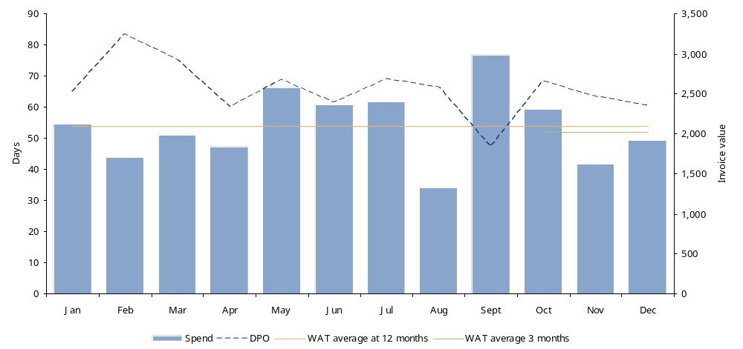
DPO versus WAT
DPO vs. WAT (3/12 Month Average)
Example of invoices being paid early
Note: […]
Source: […]
Example Data only

Slide 27
Days to Pay (DTP)
Purpose
  To measure days taken by the Company on pay invoices. This monitors performance at a more detailed level than DPO. Used to estimate and monitor terms enhancement programmes as it measures as a monthly basis how payment performance is changing.
Reporting level
  FD/PD/TR: All spend, All influenceable spend by Pareto class, by Portfolio and Pareto class.
  PB: By Portfolio.
Data scope
  Same as DPO.
Data requirement
  All invoices paid to suppliers during the month with invoice due dates and invoices payment dates.
  The invoice due date has to be checked to help ensure that it matches what is on the invoice (sample basis).
Calculation
  Calculate for every invoice the gap between the payment date and invoice payment due date; expressed in days (Payment date – Invoice date).
  Calculate the average by weighting every difference with the invoice value and sum the difference to calculate the total average days.
  (Paid Date – Invoice Date) x Invoice Value
  Sum of invoices paid in the period (month)
Frequency
  Every month end closure for the months, average across 12 months.
Output
  Measured against Days to Terms (see page 10).
FD: Financial Director / PD: Procurement Director / TR: Treasurer / PB : Procurement Buyer

Slide 28
Days to Terms (DTT)
Purpose
  To measure the days terms on paid invoices. This monitors average terms at a more detailed level than WAT. Used to estimate and monitor terms enhancement programs by measuring the gap between invoice date and due date.
Reporting level
  FD/PD/TR: All spend, All influenceable spend by Pareto class, by Portfolio and Pareto class.
  PB: By Portfolio.
Data scope
  All external suppliers.
Data requirement
  All invoices paid to suppliers during the months with invoice due dates and invoices document dates.
  The invoice due date has to be checked to help ensure that it matches what is on the invoice (sample basis?).
Calculation
  Calculate for every invoice the gap between the recorded due date and the due date per the invoice; expressed in days (Recorded due date – Invoice due date).
  Calculate the average by weighting every difference with the invoice value and sum the difference to calculate the total average days.
  (Due Date – Invoice Date) x Invoice Amount
  Total spend in period/customer
Frequency
  Every month end closure for the months, average across 12 months.
Output
  Measured against DTP (see pages 9 and 11)
FD: Financial Director / PD: Procurement Director / TR: Treasurer / PB : Procurement Buyer

Slide 29
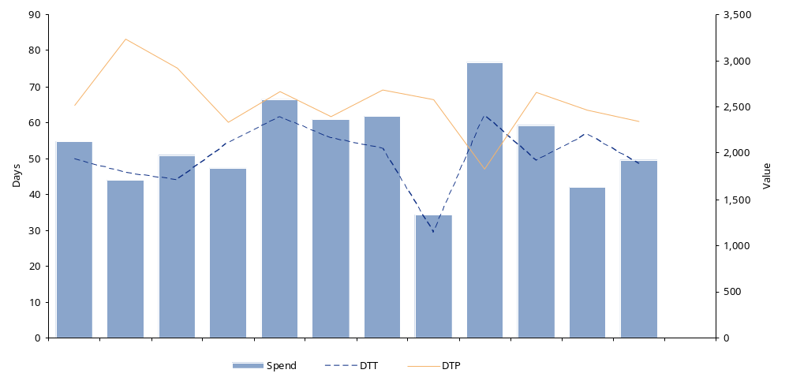
Days to Pay versus Days to Terms analysis
Days to pay versus days to terms analysis
Note: DTP Standard refers to what Days to Pay would be if all invoices were paid on time – [Guilo to explain]
Example Data only

Slide 30
Early versus late payment analysis
Purpose
  To measure Company’s early vs. late payment by suppliers by volume and value.
Reporting level
  FD/PD/TR: All spend, All influenceable spend by Pareto class, by Portfolio and Pareto class.
  PB: By Portfolio.
Data scope
  All external suppliers.
Data requirement
  All invoices paid to suppliers during the months with invoice due dates and invoices document dates.
  The invoice due date has to be checked to help ensure that it matches what is on the invoice (sample basis?).
Calculation
  Calculate for every invoice the gap between Invoice due date and invoice payment due date; expressed in days (Invoice payment date – Invoice due date).
  Calculate the average by weighting every difference with the invoice value and sum the difference to calculate the total average days, by supplier and then group suppliers spend and number by same early late days.
  (Invoice Payment Date – Invoice Due Date) x Invoice amount
  Total Invoice Value
Frequency
  Every month end closure for the months, average across 12 months.
FD: Financial Director / PD: Procurement Director / TR: Treasurer / PB : Procurement Buyer

Slide 31
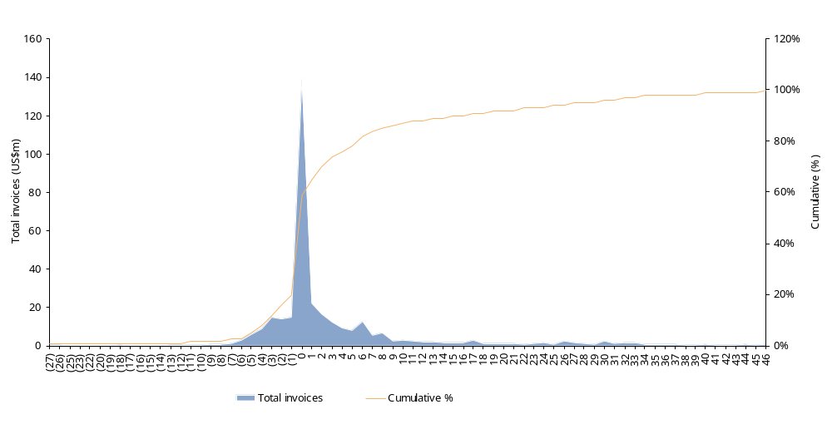
Early versus late payment analysis (cont.)
Total invoices paid late/early
Company X
Company Y
Company Z
Example Data only

Slide 32
Pareto of suppliers
Purpose
  To identify the top suppliers who represent the majority of the annual spend. Using Pareto distribution, 80% of spend is usually represented by around 20% of all suppliers.
Reporting level:
  FD/PD/TR: Top Supplier across portfolios.
  PB: By Portfolio.
Data scope
  All external suppliers.
Data requirement
  Complete list of external suppliers with annual spend value.
  Actual payment terms.
  Number of annual invoices / supplier .
Calculation
  Using payables ledger, calculate suitable payables balance cut-off level, which comprises 80% of payables value. This will usually represent roughly the top 20% of the suppliers.
Frequency
  Every six months.
FD: Financial Director / PD: Procurement Director / TR: Treasurer / PB : Procurement Buyer

Slide 33
Pareto of suppliers (cont.)
80% Value (€29 million) in 13% (220#) of the supplier base
Supplier code | Supplier name | 12 mth invoice | Inv No | Pareto Valore | Pareto Volume | Terms | Amount | Inv No | Terms | Amount | Terms | Amount | Inv no
1 500430 | PRYM CONSUMER G | 1,641,073 | 74 | 4% | 0% | Z161 | 1,642,390 | 55 | A090 | 5,915 | 7 PT MISSING - | 7,232 | 12
2 502168 | ZUST & BACHMEIE | 1,599,571 | 217 | 9% | 0% | A060 | 1,556,229 | 213 | Z104 | 43,342 | 4
3 505640 | GENERALI PROPER | 632,730 | 8 | 10% | 0% | Z104 | 642,817 | 6 | PT MISSING - | 10,087 | 2
4 500739 | LUCENSE TRASPOR | 587,377 | 55 | 12% | 0% | A060 | 612,634 | 52 | PT MISSING - | 25,257 | 3
5 506081 | OLD COMPANY SRL | 554,269 | 11 | 14% | 0% | A060 | 554,269 | 11
6 505604 | PRYM CONSUMER G | 431,466 | 36 | 15% | 0% | Z161 | 432,663 | 34 | PT MISSING - | 1,197 | 2
7 505517 | ENI S.P.A. | 430,761 | 38 | 16% | 0% | Z104 | 428,901 | 44 | A090 | 1,859 | 5
8 502277 | BARTOLINI S.P.A | 420,773 | 53 | 17% | 0% | A030 | 325,861 | 15 | Z104 | 94,912 | 9
9 500803 | GIOVANNI SABO'- | 411,198 | 16 | 18% | 1% | A030 | 411,324 | 28 | PT MISSING - | 126 | 1
10 504416 | ISPE S.N.C. DI | 407,770 | 30 | 19% | 1% | A090 | 367,188 | 26 | Z171 | 35,541 | 1 A030 | 5,041 | 1
11 501142 | ORNAGHI FILATI | 399,517 | 26 | 20% | 1% | A090 | 399,517 | 117
12 503763 | PRIOGLIO TOMASO | 395,794 | 119 | 21% | 1% | A030 | 387,342 | 19 | Z070 | 8,452 | 2
13 505194 | HILATURAS LLAUD | 380,099 | 25 | 22% | 1% | A060 | 235,507 | 11 | A030 | 144,591 | 6
14 505529 | DIB EGYPT LTD L | 370,479 | 12 | 23% | 1% | A090 | 371,456 | 19 | PT MISSING - | 977 | 1
15 506384 | CONSORZIO ENERG | 348,061 | 19 | 24% | 1% | Z104 | 348,061 | 7
16 504060 | PROMOTIONPLUS S | 337,966 | 7 | 25% | 1% | A060 | 337,966 | 16
17 501946 | FILMAN SRL | 334,572 | 18 | 26% | 1% | A090 | 328,381 | 23 | Z185 | 6,775 | 1 Z104 - | 584 | 1
18 501344 | R-INTERNATIONAL | 328,167 | 23 | 27% | 1% | Z104 | 328,167
19 501592 | CONSORZIO PREMA | 326,793 | 29 | 28% | 1% | A060 | 334,560 | 28 | PT MISSING - | 7,767 | 1
216 504737 | SCOTTI MANGIARO | 38,316 | 18 | 79% | 13% | A060 | 26,580 | 15 | Z104 | 11,736 | 3
217 504912 | BENEDETTI ALESS | 38,227 | 8 | 79% | 13% | Z043 | 38,227 | 8
218 500759 | ANILINER SRL | 38,182 | 12 | 79% | 13% | A090 | 36,104 | 11 | A060 | 2,078 | 1
219 505855 | CNS DI ALESSAND | 37,241 | 2 | 79% | 13% | A030 | 37,241 | 2
220 505448 | AMC TAP SERVICE | 37,172 | 76 | 80% | 13% | A060 | 37,187 | 74 | PT MISSING - | 15 | 2
221 505969 | SIMATEX SRL | 37,171 | 3 | 80% | 14% | A090 | 22,022 | 2 | A060 | 15,149 | 1
222 502178 | CARTOGRAFICA GA | 37,112 | 13 | 80% | 14% | A090 | 37,112 | 13
223 503816 | COOP LOMBARDIA | 880 | 2 | 80% | 14% | Z161 | 36,880 | 2
Example Data only

Slide 34
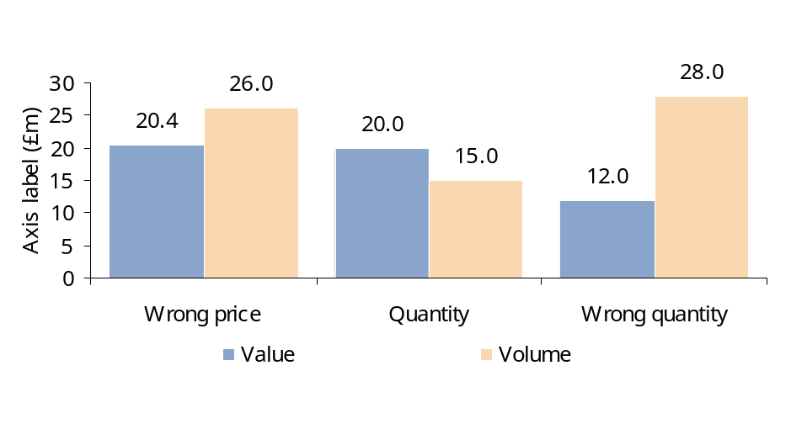
Credit notes analysis
Purpose
  To understand causes of Credit notes. Analysis of root causes enables eradication of major sources of disputes with suppliers.
Reporting level
  FD/TR: All spend.
  PD: All spend / By Portfolio.
  PB: For each Portfolio: by Commodity/ Supplier.
Data scope
  All external suppliers.
Data requirement
  Credit notes with value and reason.
Calculation
  Credit note reason as a percentage of total for volume and value.
Frequency
  Every month end closure.
Number as a percentage of total number of invoices
Value of credit notes as a percentage of the total value of invoices
Example Data only
FD: Financial Director / PD: Procurement Director / TR: Treasurer / PB : Procurement Buyer

Slide 35
Credit notes analysis
Pareto analysis of Credit Note over last 12 months
Credit notes by value
Supplier | Name | CN amount |  | No. of docs | Pareto value | Cum no. | Pareto volume
501164 | G.S. SpA | 109,084.9 |  | 1 | 32% | 1 | 1%
506013 | S.S.C. | 48,789.7 |  | 1 | 46% | 2 | 1%
500739 | Lucense traspor | 25,256.9 |  | 3 | 54% | 5 | 4%
501250 | Selene SpA | 23,202.0 |  | 1 | 60% | 6 | 4%
505640 | Generali Proper | 10,087.1 |  | 2 | 63% | 8 | 6%
502187 | Ma.Re. SpA | 9,815.2 |  | 1 | 66% | 9 | 7%
500737 | Robots SpA | 8,652.7 |  | 2 | 69% | 11 | 8%
506168 | Edit Srl | 8,160.0 |  | 1 | 71% | 12 | 9%
506286 | Accessorio Piu' | 8,009.4 |  | 1 | 73% | 13 | 10%
501592 | Consorzio Prema | 7,767.2 |  | 1 | 76% | 14 | 10%
503287 | Hft Srl | 6,677.4 |  | 2 | 78% | 16 | 12%
501305 | Panorama SpA | 6,621.8 |  | 1 | 80% | 17 | 13%
505307 | Twist Internati | 6,114.9 |  | 2 | 81% | 19 | 14%
505174 | Associazione Te | 4,269.7 |  | 1 | 83% | 20 | 15%
502523 | Ellepack Srl | 4,111.5 |  | 1 | 84% | 21 | 15%
504944 | Alba 94 Soc. Co | 3,617.6 |  | 2 | 85% | 23 | 17%
503252 | Billa a.G. | 3,000.0 |  | 1 | 86% | 24 | 18%
500691 | Milano Ad Srl | 2,716.8 |  | 1 | 87% | 25 | 18%
502486 | Sumar SpA | 2,682.8 |  | 1 | 87% | 26 | 19%
500653 | Sicem Snc | 2,544.0 |  | 1 | 88% | 27 | 20%
504873 | Otis Servizi S. | 2,524.6 |  | 2 | 89% | 29 | 21%
500772 | Esselunga SpA | 2,520.0 |  | 1 | 90% | 30 | 22%
Total
Example Data only

Slide 36
Discounts taken analysis
Purpose
  To measure the ability to pay suppliers on time in order to take the negotiated discount.
Reporting level
  FD/PD/TR: All spend.
  PB: By Portfolio.
Data scope
  All external suppliers.
Data requirement
  All invoices paid to external suppliers during the month, with payment terms and discounts available and discounts taken.
Calculation
  Monthly Discounts taken as a percentage of Total Monthly Spend.
  Monthly Discounts taken as a percentage of Monthly Discounts Available.
Frequency
  Every month end closure.
FD: Financial Director / PD: Procurement Director / TR: Treasurer / PB : Procurement Buyer

Slide 37
Discounts taken analysis (cont.)
Analysis of interest paid
Month | Total monthly spend € | Monthly spend on contracts with discount terms | Total available monthly discount | Total monthly discounts taken | % of total monthly spend discounted | Discounts taken as a percentage of available discount
Jan-01 | 5,432,319 | 3,770,434 | 430,982 | 227,093 | 4.2% | 53%
Feb-01 | 3,475,188 | 1,232,940 | 40,398 | 34,873 | 1.0% | 86%
Mar-01 | 7,155,322 | 1,409,690 | 149,823 | 98,323 | 1.4% | 66%
Apr-01 | 4,489,169 | 2,407,324 | 294,803 | 283,762 | 6.3% | 96%
May-01 | 5,616,680 | 2,006,295 | 109,832 | 49,837 | 0.9% | 45%
Jun-01 | 3,927,846 | 2,130,143 | 209,843 | 98,726 | 2.5% | 47%
Jul-01 | 5,809,025 | 2,473,494 | 82,734 | 28,746 | 0.5% | 35%
Aug-01 | 3,040,864 | 2,540,690 | 50,983 | 49,873 | 1.6% | 98%
Sep-01 | 6,905,085 | 2,153,474 | 152,098 | 84,082 | 1.2% | 55%
Oct-01 | 7,226,577 | 2,571,115 | 109,324 | 47,893 | 0.7% | 44%
Nov-01 | 5,164,729 | 2,407,419 | 309,843 | 193,872 | 3.8% | 63%
Dec-01 | 4,373,019 | 1,673,439 | 109,832 | 98,746 | 2.3% | 90%
Totals | 62,615,823 | 26,776,457 | 2,050,495 | 1,295,826 | 2.1% | 63.2%
Example data only

Slide 38
Discount terms analysis
Objective
  Analyse value of each discounted terms compared to cash discount value to understand current trade of and effective presence of a group strategy.
Reporting level and reporting channel
  FD, SD by suppliers channel.
Data scope
  Third parties suppliers.
Data requirement:
  Spend by suppliers by term].
  N invoices by suppliers by term.
Calculation
  Calculate value in days of each % discounted term compared to net option.
Frequency
  Monthly.
FD: Financial Director / SD: Supplier Director

Slide 39
Discount terms analysis (cont.)
Discount terms analysis
Terms | % of total receipts | Days granted per percentage point
5 days 3%, 30 days net | 13% | 5
3 days 4%, 30 days net | 7% | 7
20 days 3%, 30 days net | 4% | 3
20 days 2%, 30 days net | 3% | 5
30 days 2%, 45 days net | 2% | 8
15 days 2%, 30 days net | 2% | 8
Note: […] Source: […]
Example data only

Slide 40
Volume discounts taken
Purpose
  To measure the ability to pay suppliers in order to take the negotiated volume discounts.
Reporting level
  FD/PD/TR: All spend.
  PB: By Portfolio.
Data scope
  All external suppliers.
Data requirement
  All invoices paid to external suppliers during the year with target volume.
  Detailed volume contract condition (example: % of discount per total volume or incremental volume).
Calculation
  Calculate volume remaining to target volume discount and Volume Discount earned so far.
Frequency
  Year end.
FD: Financial Director / PD: Procurement Director / TR: Treasurer / PB : Procurement Buyer

Slide 41
Volume discounts taken (cont.)
Volume discounts taken
Terms Description | Total Spend YTD EURO | Current Discount % | Current volume discount applicable | Current value discount | Next volume discount % | Next volume discount applicable | Next value discount | Next level marginal discount | Value to be still ordered for next level discount | Net volume to be ordered
Customer 1 | 55,654,565 | 3.0 | 55,000,000 | 1,669,637 | 4.0 | 60,000,000 | 2,400,000 | 730,363 | 4,345,435 | 3,615,072
Customer 2 | 44,150,123 | 4.0 | 40,000,000 | 1,766,005 | 5.5 | 45,000,000 | 2,475,000 | 708,995 | 849,877 | 140,882
Customer 3 | 34,287,293 | 3.0 | 15,000,000 | 1,028,619 | 5.0 | 35,000,000 | 1,750,000 | 721,381 | 712,707 | -8,674
Customer 4 | 19,664,454 | 2.0 | 15,000,000 | 393,289 | 3.0 | 20,000,000 | 600,000 | 206,711 | 335,546 | 128,835
Customer 5 | 18,371,840 | 3.0 | 15,000,000 | 551,155 | 4.5 | 20,000,000 | 900,000 | 348,845 | 1,628,160 | 1,279,315
Customer 6 | 13,267,665 | 2.0 | 10,000,000 | 265,353 | 2.5 | 15,000,000 | 375,000 | 109,647 | 1,732,335 | 1,622,688
Customer 7 | 12,923,656 | 3.0 | 10,000,000 | 387,710 | 4.0 | 15,000,000 | 600,000 | 212,290 | 2,076,344 | 1,864,054
Customer 8 | 9,667,832 | 2.0 | 5,000,000 | 193,357 | 3.5 | 10,000,000 | 350,000 | 156,643 | 332,168 | 175,525
Customer 9 | 9,194,916 | 2.0 | 5,000,000 | 183,898 | 2.5 | 10,000,000 | 250,000 | 66,102 | 805,084 | 738,982
Customer 10 | 7,571,137 | 1.0 | 5,000,000 | 75,711 | 2.0 | 10,000,000 | 200,000 | 124,289 | 2,428,863 | 2,304,574
Customer 11 | 5,385,456 | 2.0 | 5,000,000 | 107,709 | 3.5 | 10,000,000 | 350,000 | 242,291 | 4,614,544 | 4,372,253
Customer 12 | 4,944,858 | 2.0 | 4,000,000 | 98,897 | 2.5 | 5,000,000 | 125,000 | 26,103 | 55,142 | 29,039
Customer 13 | 3,741,787 | 1.0 | 4,000,000 | 37,418 0 | 2.0 | 5,000,000 | 100,000 | 62,582 | 1,258,213 | 1,195,631
Customer 14 | 1,276,469 | 0.0 | - |  | 1.5 | 5,000,000 | 75,000 | 75,000 | 3,723,531 | 3,648,531
Customer 15 | 1,220,010 | 0.0 | - | 0 0 | 0.5 | 5,000,000 | 25,000 | 25,000 | 3,779,990 | 3,754,990
Customer 16 | 777,035 | 0.0 | - |  | 1.0 | 5,000,000 | 50,000 | 50,000 | 4,222,965 | 4,172,965
Customer 17 | 719,514 | 0.0 | - | 0 0 0 | 1.5 | 5,000,000 | 75,000 | 75,000 | 4,280,486 | 4,205,486
Customer 18 | 345,651 | 0.0 | - |  | 0.5 | 5,000,000 | 25,000 | 25,000 | 4,654,349 | 4,629,349
Customer 19 | 288,064 | 0.0 |  |  | 1.0 | 5,000,000 | 50,000 | 50,000 | 4,711,936 | 4,661,936
Customer 20 | 225,361 | 0.0 | - |  | 1.5 | 5,000,000 | 75,000 | 75,000 | 4,774,639 | 4,699,639
Customer 21 | 82,591 | 0.0 | - | 0 0 | 0.5 | 5,000,000 | 25,000 | 25,000 | 4,917,409 | 4,892,409
Example Data only

Slide 42
Invoice Registering Time (“Commitment to Payment”)
Purpose
  To determine the number of days needed on average to register invoices in the system.
  This analysis can be used as sample analysis or detailed analysis to confirm payment clock enhancement opportunities, based upon syncing the receiving of goods, the receiving of the invoice and the invoice date.
Reporting level
  Same as DTT.
Data scope
  All external suppliers.
Data requirement
  All invoices received dates.
  All invoices registration dates.
Calculation
  Calculate for every invoice the gap between invoice registration date and invoice date; expressed in days (Registration date – Invoice date).
  Calculate the average by weighting by invoice value.
Frequency
  Every month end closure.
FD: Financial Director / PD: Procurement Director / TR: Treasurer / PB : Procurement Buyer

Slide 43
Invoice Registering Time (“Commitment to Payment”) (cont.)
Supplier Name: | ABC Ltd
Supplier Account: | 100244
 | Order | Delivery requested | Delivery received | Invoice | Inv. Receipt by Company | Inv. Receipt by AP | Entered into SAP | Sent for authorisation | Receipt of authorised inv. | Posted in SAP | Payment due date | Actual payment
 | A | B | C | D | E | F | G | H | I | J | K | L
 |  | 01/01/2007 | 03/01/2007 | 01/02/2007 | 03/02/2007 | 22/02/2007 | 11/03/2007 | 28/03/2007 | 14/04/2007 | 03/05/2007 | 20/05/2007 | 06/06/2007
 |  | 02/01/2007 | 04/01/2007 | 02/02/2007 | 04/02/2007 | 23/02/2007 | 12/03/2007 | 29/03/2007 | 15/04/2007 | 04/05/2007 | 21/05/2007 | 07/06/2007
 |  | 03/01/2007 | 05/01/2007 | 03/02/2007 | 05/02/2007 | 24/02/2007 | 13/03/2007 | 30/03/2007 | 16/04/2007 | 05/05/2007 | 22/05/2007 | 08/06/2007
 |  | 04/01/2007 | 06/01/2007 | 04/02/2007 | 06/02/2007 | 25/02/2007 | 14/03/2007 | 31/03/2007 | 17/04/2007 | 06/05/2007 | 23/05/2007 | 09/06/2007
 |  | 05/01/2007 | 07/01/2007 | 05/02/2007 | 07/02/2007 | 26/02/2007 | 15/03/2007 | 01/04/2007 | 18/04/2007 | 07/05/2007 | 24/05/2007 | 10/06/2007
 |  | 06/01/2007 | 08/01/2007 | 06/02/2007 | 08/02/2007 | 27/02/2007 | 16/03/2007 | 02/04/2007 | 19/04/2007 | 08/05/2007 | 25/05/2007 | 11/06/2007
 |  | 07/01/2007 | 09/01/2007 | 07/02/2007 | 09/02/2007 | 28/02/2007 | 17/03/2007 | 03/04/2007 | 20/04/2007 | 09/05/2007 | 26/05/2007 | 12/06/2007
 |  | 08/01/2007 | 10/01/2007 | 08/02/2007 | 10/02/2007 | 01/03/2007 | 18/03/2007 | 04/04/2007 | 21/04/2007 | 10/05/2007 | 27/05/2007 | 13/06/2007
 |  | 09/01/2007 | 11/01/2007 | 09/02/2007 | 11/02/2007 | 02/03/2007 | 19/03/2007 | 05/04/2007 | 22/04/2007 | 11/05/2007 | 28/05/2007 | 14/06/2007
 |  | 10/01/2007 | 12/01/2007 | 10/02/2007 | 12/02/2007 | 03/03/2007 | 20/03/2007 | 06/04/2007 | 23/04/2007 | 12/05/2007 | 29/05/2007 | 15/06/2007
 |  | 11/01/2007 | 13/01/2007 | 11/02/2007 | 13/02/2007 | 04/03/2007 | 21/03/2007 | 07/04/2007 | 24/04/2007 | 13/05/2007 | 30/05/2007 | 16/06/2007
 |  | 12/01/2007 | 14/01/2007 | 12/02/2007 | 14/02/2007 | 05/03/2007 | 22/03/2007 | 08/04/2007 | 25/04/2007 | 14/05/2007 | 31/05/2007 | 17/06/2007
 |  | 13/01/2007 | 15/01/2007 | 13/02/2007 | 15/02/2007 | 06/03/2007 | 23/03/2007 | 09/04/2007 | 26/04/2007 | 15/05/2007 | 01/06/2007 | 18/06/2007
 |  | 14/01/2007 | 16/01/2007 | 14/02/2007 | 16/02/2007 | 07/03/2007 | 24/03/2007 | 10/04/2007 | 27/04/2007 | 16/05/2007 | 02/06/2007 | 19/06/2007
 |  | 15/01/2007 | 17/01/2007 | 15/02/2007 | 17/02/2007 | 08/03/2007 | 25/03/2007 | 11/04/2007 | 28/04/2007 | 17/05/2007 | 03/06/2007 | 20/06/2007
 |  | 16/01/2007 | 18/01/2007 | 16/02/2007 | 18/02/2007 | 09/03/2007 | 26/03/2007 | 12/04/2007 | 29/04/2007 | 18/05/2007 | 04/06/2007 | 21/06/2007
Total
Weighted average
Delivery performance |  |  | 2
Pre-invoicing |  |  |  | 29
Postal delays |  |  |  |  | 2
Internal postal delays |  |  |  |  |  | 19
Processing delays to sap |  |  |  |  |  |  | 17
Processing delays |  |  |  |  |  |  |  | 17
Authorisation delays |  |  |  |  |  |  |  |  | 17
Posting delays |  |  |  |  |  |  |  |  |  | 19
Payment terms per 'agreement' |  |  |  |  |  |  |  |  |  |  | 108
Actual payment terms |  |  |  |  |  |  |  |  |  |  |  | 34
Example Data only
Example Data only

Slide 44
Unapproved invoices (Blocked) Reason Code
Purpose
  To measure invoices stopped due to poor supplier performance.
Reporting level
  FD/PD all spend
  PB by portfolio
Data scope
  All external suppliers.
Data requirement
  Unapproved or blocked invoice data: value, reason code for blocking.
Calculation
  Measure value/volume per reason code.
Frequency
  Minimum one or two a month.
FD: Financial Director / PD: Procurement Director / TR: Treasurer / PB : Procurement Buyer

Slide 45
Unapproved invoices (Blocked) Reason Code (cont.)
Invoices blocked reason code
Blocking reason code | Nr documents with open dispute | Nr documents blocked | Value with dispute | Value with blocked
Early delivery | 3 | 1 | 34,234 | 11,411
Incorrect coding | 41 | 4 | 24,234 | 15,142
No PO | 14 | 2 | 42,342 | 16,805
No GRN | 3 | 2 | 1,233 | 1,190
Diff qty | 14 | 5 | 12,312 | 11,863
Incorrect price | 4 | 0 | 5,234 | 3,794
Wrong product | 41 | 0 | 23,432 | 10,378
Returned product | 4 | 0 | 2,344 | 2,299
Diff contract terms | 23 | 12 | 3,432 | 1,809
Damage product | 34 | 21 | 1,414 | 923
Contract renegotiation | 43 | 11 | 41,414 | 22,548
Invoice error | 23 | 13 | 4,124 | 3,002 | 94,585
Total |  |  | 195,749 | 101,164
Example Data only

Slide 46
Appendix
Overview of Approach for Release of Working Capital Opportunities

Slide 47













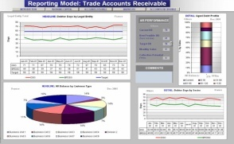
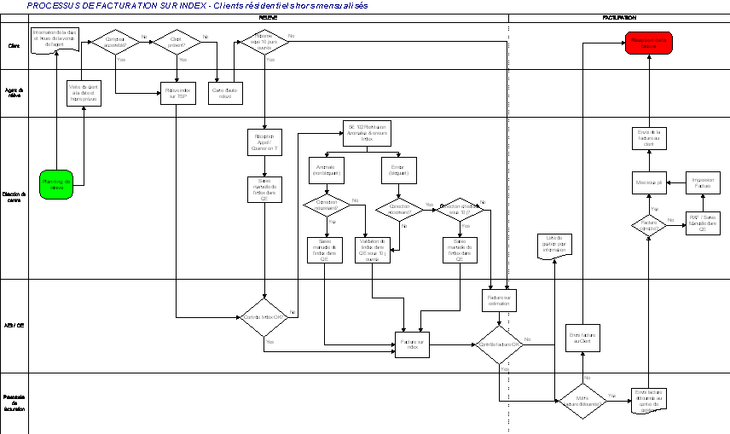
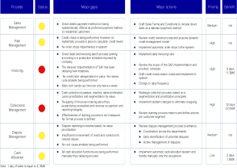
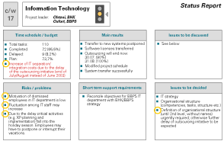
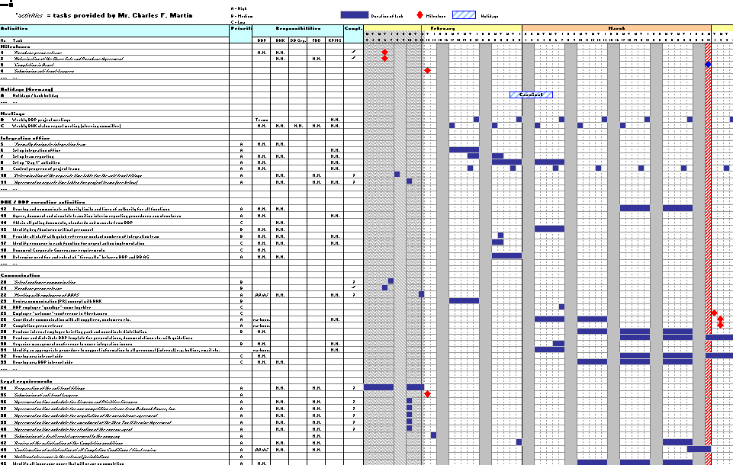
Overview of Approach for Release of Working Capital Opportunities
KPMG’s approach focuses on understanding cash and working capital performance from both an analytical as well as from an operational point of view.
Assess
process, policy
and organisation
Identify gaps to better practice
Evaluate root causes
Quantify
Improvement potential for
short to
medium term
Prepare
action plan
Interviews
4
Actual
performance
Analyze systems, tools and information accuracy
Assess Cash Flow and Working Capital performance
1
Workshops
Establish
performance
baseline
Assess key performance drivers and root causes
2
3
Best Possible
performance
Analyze
reporting, KPIs,
and incentives
Data analysis
Analyse
staffing levels, and
competences.
HR
Example Deliverables
Performance review
and target setting
Process maps
Best practice
gap analysis
Detailed
recommendations
Action planning

